Slide 1
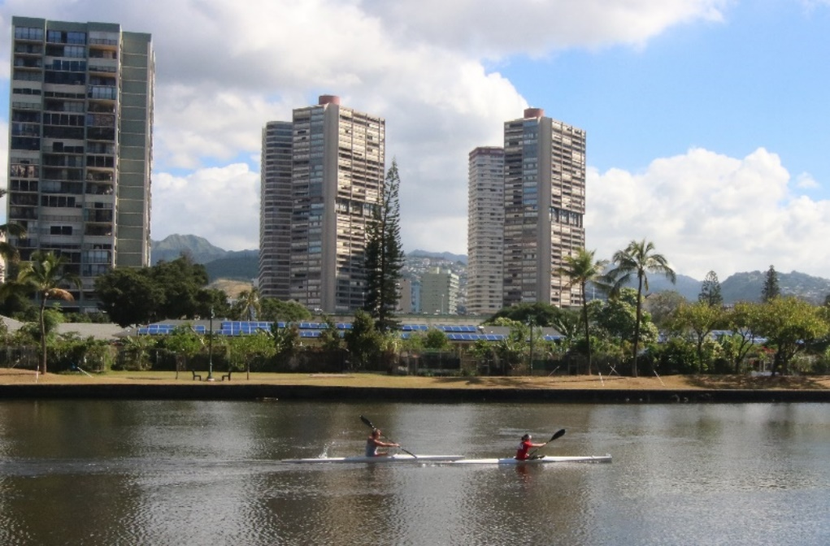
Hawaii’s DER Management Initiative Opportunities for Customer-sited Grid Services Delivery
Rich Barone
Manager, Demand Response
Hawaiian Electric

Slide 2
Renewable Energy Challenges: System Stability

Slide 3
Risk: Minimum Loads
PV reduces mid-day net loads
Generators running a production minimums
Inefficient
Risk of tripping off
Hidden loads create load balancing risks
Notes:
The system could go if a contingnecy event happens

Slide 4
Risk Management: Load Shifting
Load shifting can be event or pricing-based
These programs can persuade customers to increase their demand during peak times
Water heaters, water and waste water tanks, Storage, EV’s
Vulnerable Generators
Shift Load from Peak to Day Time minimum
Stable System

Slide 5
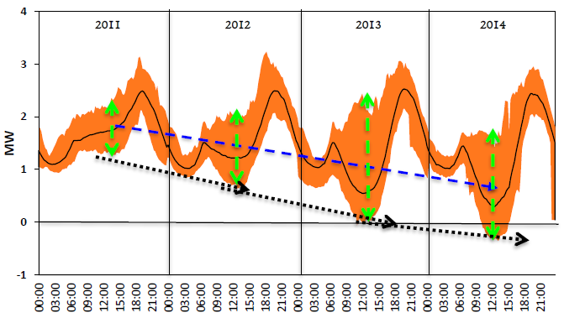
Risk: Increased Variation on Circuit
More PV = more variability on circuit
Circuit variability drives the need for more Regulating Reserves
Actual Annual Circuit Net Load (Residential Circuit)

Slide 6
Risk Management: Regulating Reserve Program
Variation in load can be compensated with increased regulating reserve (RR) resources
Demand Response can provide RR
GIWH can react to 2 sec AGC data
Variability on circuit
More Regulating Reserves
Stable System

Slide 7
Building the Market: Grid Service Tariff Orientation
Capacity Grid Service
Fast Frequency Response
Capacity: for dispatchable resources -the rating of the unit; for variable resources- the capacity that can be assured in the next 4 hours; for controlled load- the minimum of load under control during the 24-hour day.
Fast Frequency Response is needed to reduce the rate of change of frequency (RoCoF) to help stabilize system frequency immediately following a sudden loss of generation or load, proportional to the loss.
Regulating Reserve Grid Service
Replacement Reserve Grid Service
Regulating Reserves are maintained to respond to supply/demand imbalances over much shorter time frames, typically on the order of one to several seconds.
Replacement reserves replace the output of faster responding reserves (or restoration of shed loads) enabling their redeployment; meet sustained ramps and forecast errors beyond Regulating Reserve duration.

Slide 8
Building the Market: Demonstration Phase
Regulating Reserves 100 customers providing 730 kW
Team A | 95 customers, mix of commercial and residential (Oahu and Maui)
Team B | 2 residential PV + Storage
Team C | 1 C&I customer with storage, enabling devices
Team D | 2 energy storage for large C&I customer
Fast Frequency Reserves 3 customers providing 135 kW
Team B | 2 residential PV + Storage
Team C | 1 C&I customer with storage, enabling devices
Capacity (Load Shifting) 47 customers providing 101.5 kW
Team B | 10 residential PV + Storage
Team C | 1 C&I customer with storage, enabling devices
Team E | 30 customer self supply customers (PV + Storage)
Team F | 5 small business customers with thermostat

Slide 9
Timeline
DR Policy Statement
April 2014
Service Definition, potential
Dec 2015
DR Portfolio Application
Feb 2017
Service Valuing December 2016
Demonstration Projects October 2016
Launch Portfolio Fall 2017

Slide 10
Building the Market: Aggregators
Gaging the potential for a Grid Services marketplace
Grid Services RFP (May 2015)
Short-listed vendors
Demonstration projects
Grid Services Purchase Agreement (GSPA)
Rolling RFPs
Long-term
Auction?

Slide 11
Building the Market: Self-aggregators
Large customers can self-aggregate and contract directly with Hawaiian Electric
Typically work with a Technical Coordinator
Customers include Board of Water Supply
Department of Defense
Department of Education
University of Hawaii

Slide 12
Building the Market: Stakeholder Engagement
Vendors
Policy
Regulatory
Customers

Slide 13
Hurdles
Internal
Operational uncertainty
Planning-operations feedback loop
Realization, verification ^ quantification of benefits
External
Market uncertainty
Technical Uncertainty
Proper value assignment

